Slide 1
Predicting Cytokine Responses From Image Embeddings
Tempest Plott
2023

Slide 2
The Problem:
Obtaining cytokine readings is an important part of biological drug screening, but is time-consuming, expensive, and risky.

Slide 3
The Solution:
If it is possible to predict cytokine response from images, then drug discovery can happen faster, with less risk, and with greater ease.

Slide 4
The Constraints:
For quick turn-around time as promised to customers, we need a method to quickly and simply generate cytokine predictions for each drug screen from massive amounts of data. Some data infrastructure is already built.

Slide 5
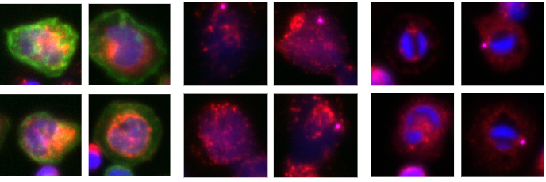
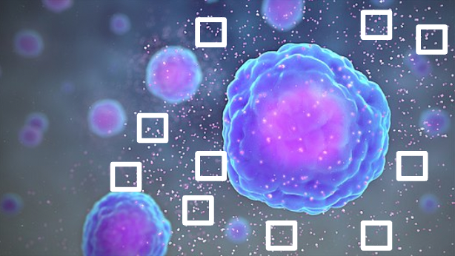

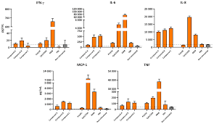

Background Information:
Real High Content Microscopy Images
Cytokine Schematic and Data Example

Slide 6
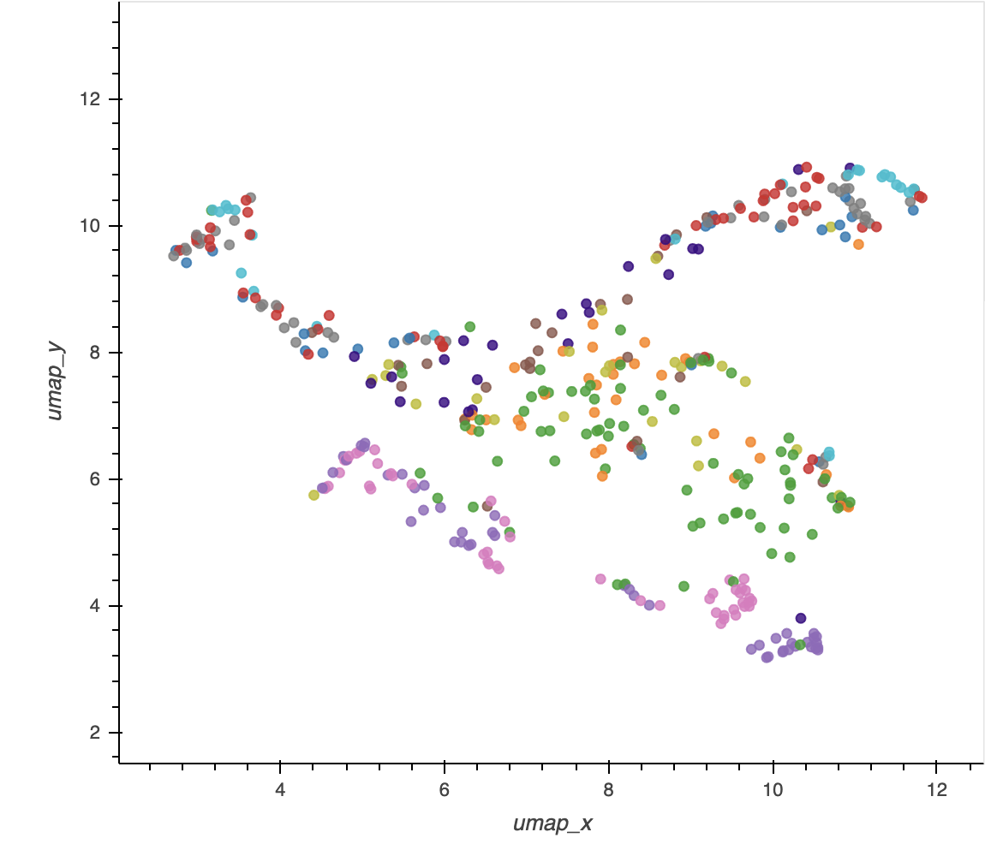
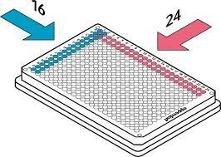

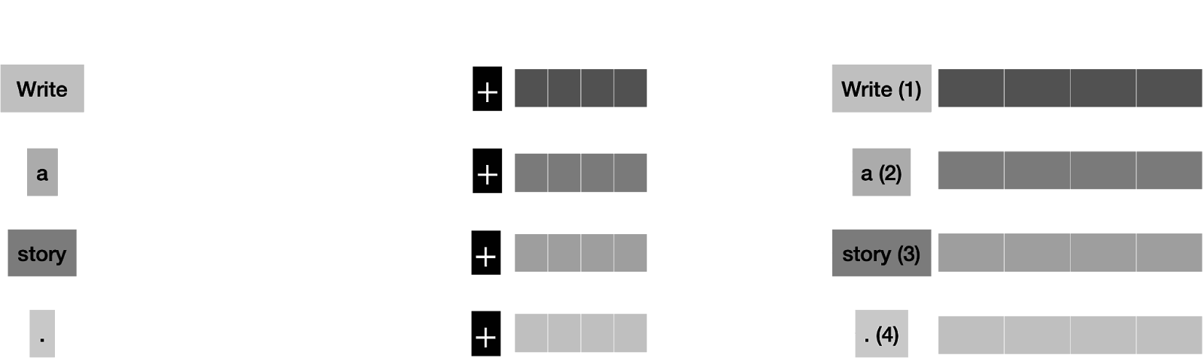
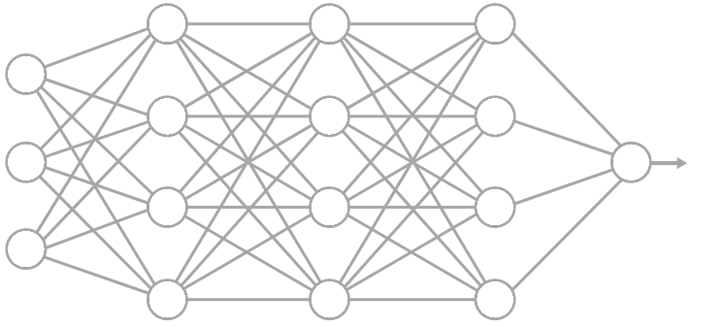
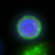
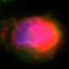
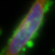
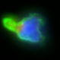
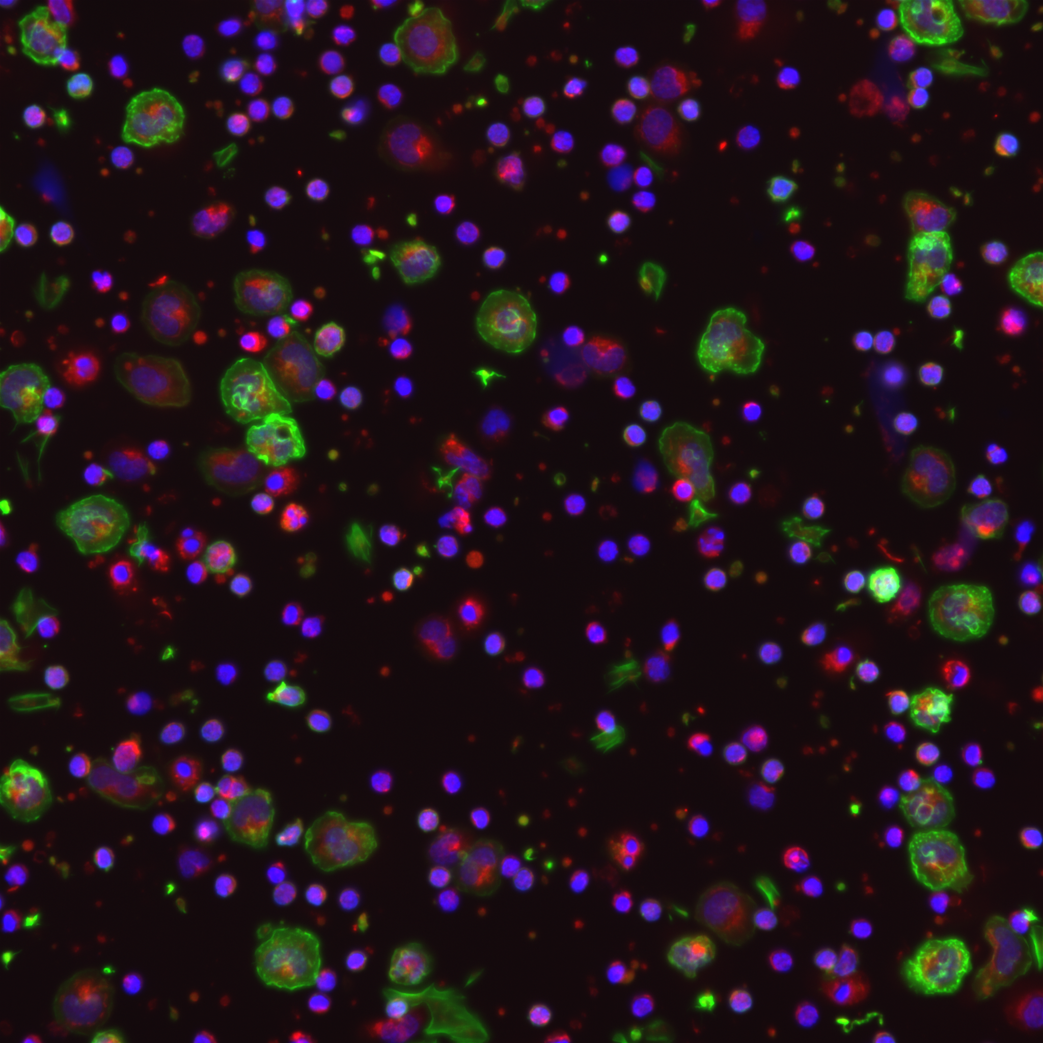
Old Screening Workflow:
Hundreds of plates filled with cells and candidate drugs
Model - predict new drug efficacy by comparing embeddings to controls!
Millions of images
Wait several weeks for cytokine readout. Risk unrecoverable experimental error. Use cytokine measurements as supplementary information. Use data separately from embeddings in cytokine specific models if requested.
Pretrained neural network trained on photographic images used as a feature extractor
High dimensional embeddings e.g. 1280 features per stain

Slide 7
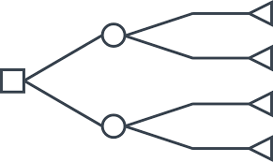
New Potential Screening Workflow:
Hundreds of plates filled with cells and candidate drugs
Model B - predict new drug efficacy by comparing embeddings to controls!
Millions of images
Pretrained neural network trained on photographic images used as a feature extractor
High dimensional embeddings e.g. 1280 features per stain
Embeddings
Cyto :
1/0
Model A - predict cytokine response!

Slide 8
The Data:
Use a proof-of-concept subset with Con-A Embeddings, 1280 features, 50 cytokines, and only one plate.

Slide 9
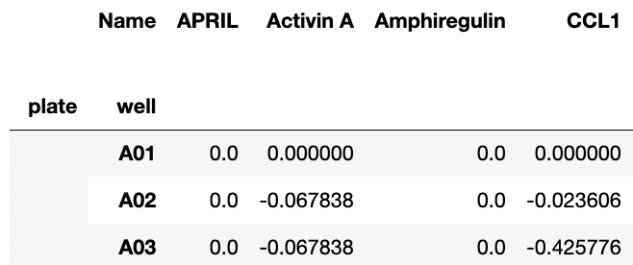
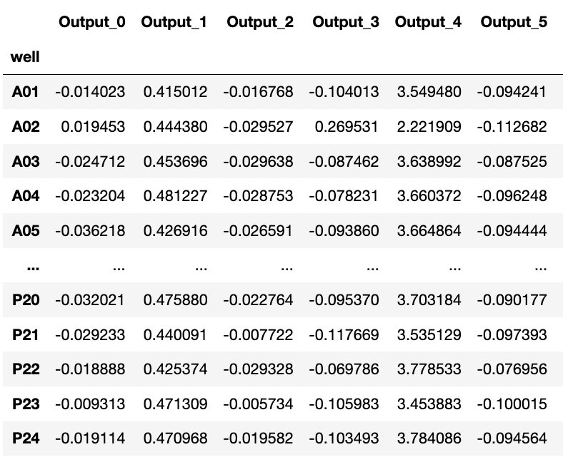
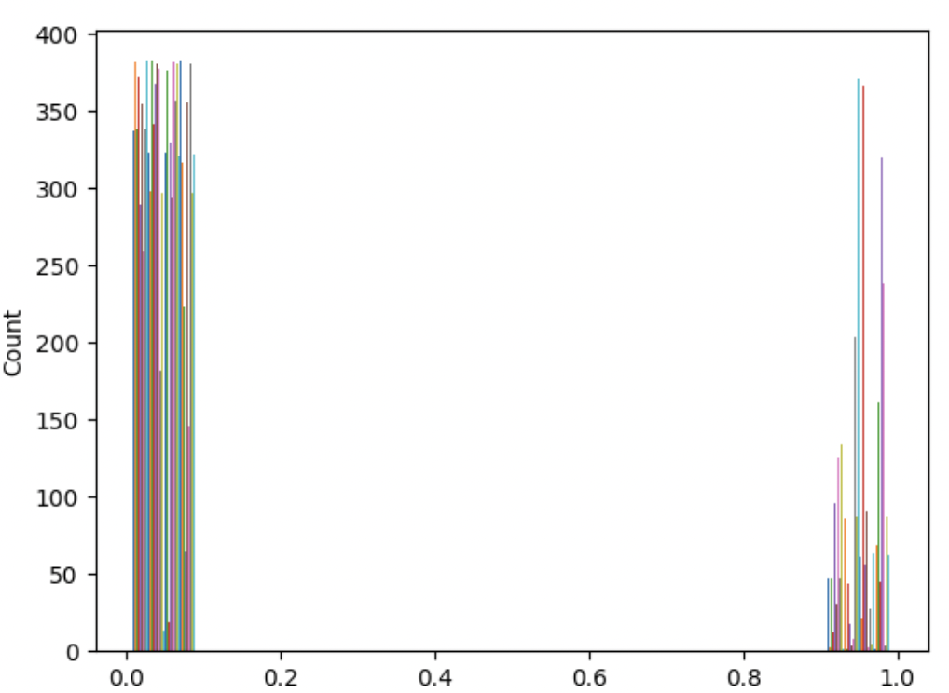
Well-Aggregated Embeddings, (Features)
Binarization and balancing of Well-Based Cytokine Readouts (Target)
<- 0s
1s ->
Notes:
Embeddings are normalized to negative control baseline and z scored and so are cytokines.
Some cytokines were removed for too few 1 wells
Kbins discretizer
Need enough to train/test split

Slide 10
Data Wrangling
Remove data that is not useful and ensure appropriate data types are enforced for later analysis.
Cytokines with no distribution at all were dropped before binarization
After binarizing and class-balancing cytokines, those with fewer than 10 remaining wells were dropped. (This is 5 positive response wells.)
Attach downsampled embeddings and labels into independent dataframes for each cytokine. Loop through these for modelling.
Notes:
(ie, change to numbers for classes for later)

Slide 11
Feature Selection
Compared results from variance thresholding, univariate feature selection (f_reg), recursive feature elimination, L1 feature elimination, a decision tree just for choosing features, sequential feature selection (logit), and PCA
XG Boost final classification model
Speed of method, number of predictable cytokines, precision, and recall were metrics of comparison.
1280 black box embedding features * 5 channels * 50 cytokines = 320,000 features! We need to choose the best way to reduce this dimensionality.
7 different feature selection methods were analyzed.
Notes:
P and R >0.65 is predictable

Slide 12
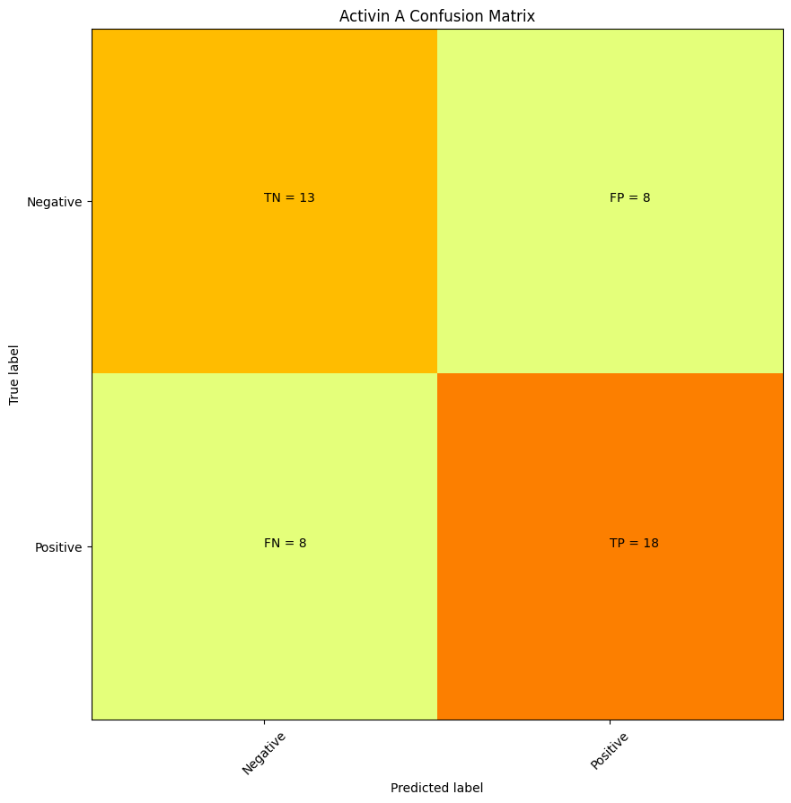
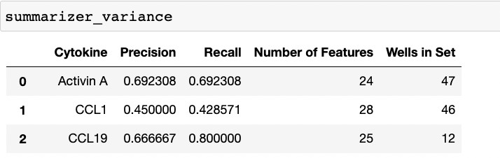
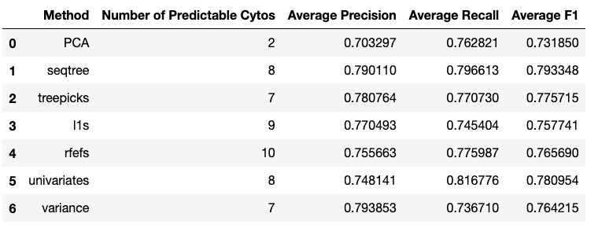
Feature Selection Results!
Notes:
A confusion matrix for every cytokine for every feature selection method, consistent XGBoost model
Summarize them all and compare. Precision, Recall >0.65 is “predictable”
No single feature jumped out as the most important

Slide 13
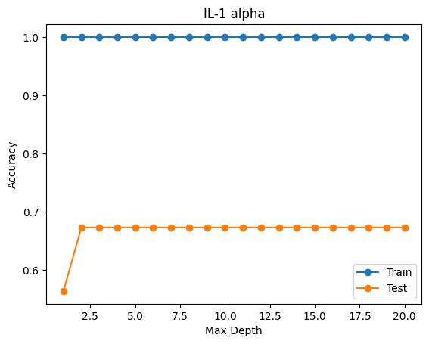
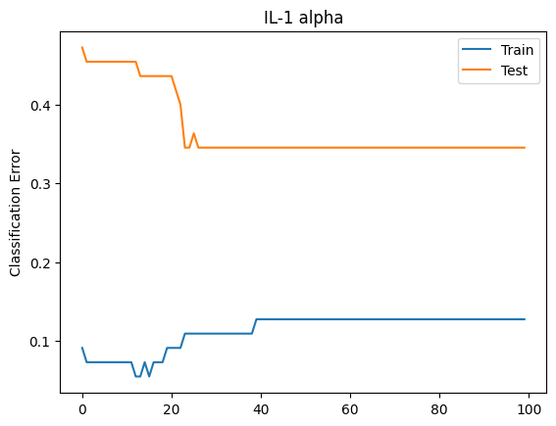
Some Tuning of “General” Model
For all cytokines, there was a trend that more than a max depth of three was not necessary.
There was not a clear early stopping point for all cytokines to avoid overfitting.
Each cytokine model will need its own hyperparameter tuning.
Learning Curve
Stopping Point
Notes:
A confusion matrix for every cytokine for every feature selection method, consistent XGBoost model
Summarize them all and compare. Precision, Recall >0.65 is “predictable”

Slide 14
Takeaways
It is possible to predict some cytokines from image embeddings!
RFE is a fast and effective way to reduce the feature space to something manageable for computation of large drug screens.
model = XGBClassifier(n_estimators=100, max_depth=3, learning_rate=0.01, objective='binary:logistic')

Slide 15
Future Work
For each predictable cytokine, tune an independent XGBoost model.
Include all 5 stains in future use of this work.

Slide 16
Questions?

